Slide 1

NALANDA
BOOK STORE
GROUP 12

Slide 2
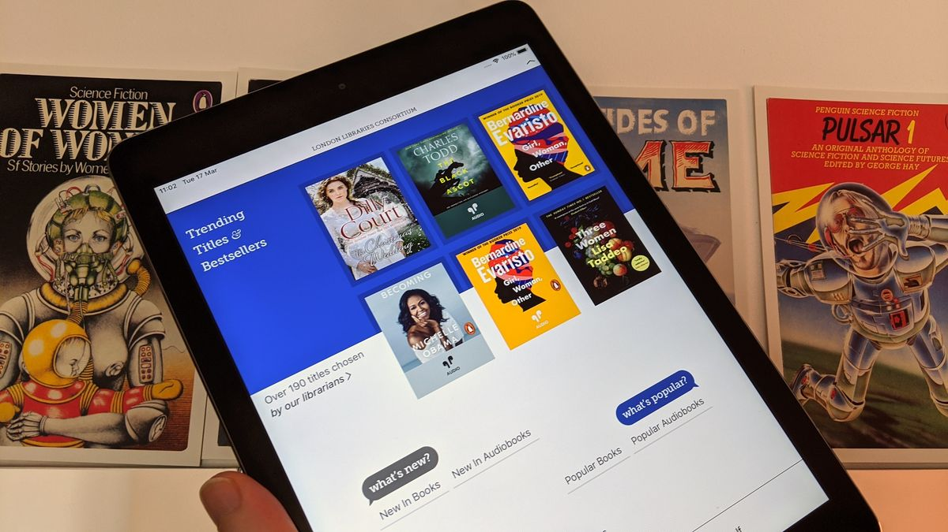
Content
01 INTRODUCTION
02 KEY FEATURES
03 RESEARCH METHODOLOGIES
04 PERSONA & SKETCHES
05 DESIGN WIREFRAME AND PROTOTYPE
06 OUR TEAM

Slide 3

Introduction
The project aims to create an online bookstore where users can purchase books based on title, author, and subject. Customers can browse books categorized into genres like Fiction, Cooking, and Adventure. They can add books to their cart and complete transactions using credit card payments. Users can register quickly or log in with existing accounts. Administrators have additional functionalities, managing and updating the database. The software boasts a user-friendly interface suitable for all levels of users.

Slide 4
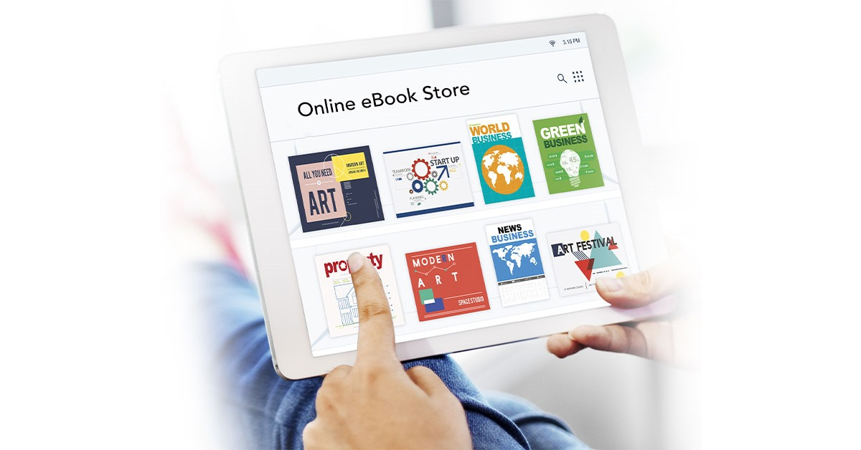
KEY FEATURES
Special deals or unique collections
Inventory management software
Reliable shipping partners
Digital rights protection
Responsive customer service
Secure payment gateways
User-friendly website design
Customer feedback
Regular updates and maintenance

Slide 5

Research Methodologies
Structured Interview
Unstructured Interview
Card Sorting
Unmoderated remote user testing
Moderated remote User testing
texthttps://drive.google.com/drive/folders/1Oz0WqLh_5qc3BdGIUCCVu6hb0B93nUSi?usp=drive_link

Slide 6
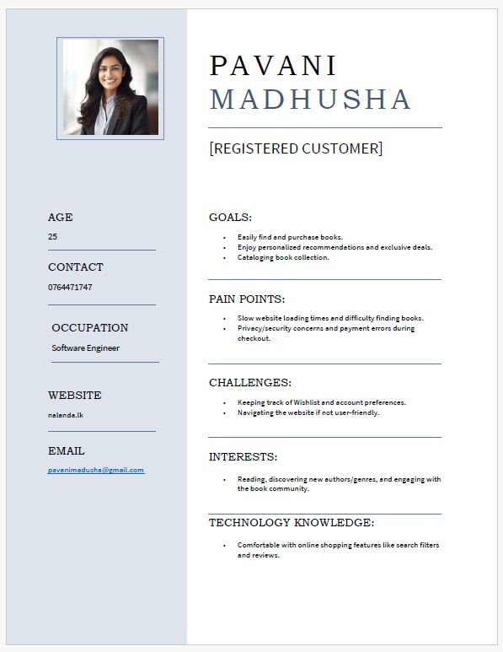
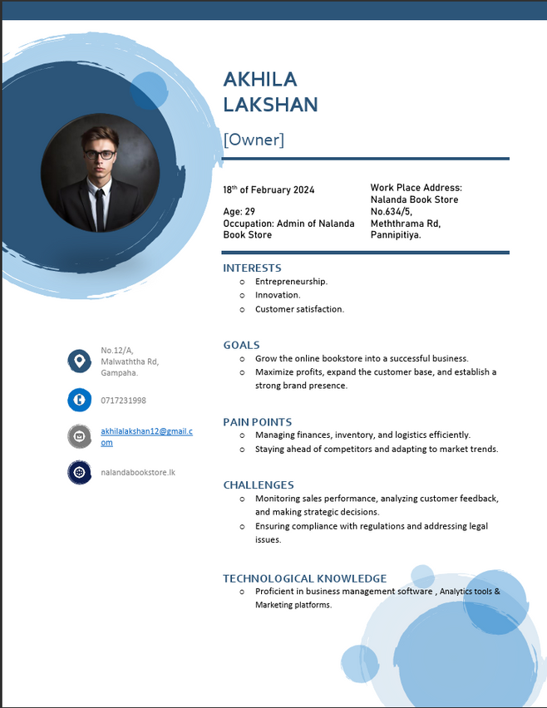

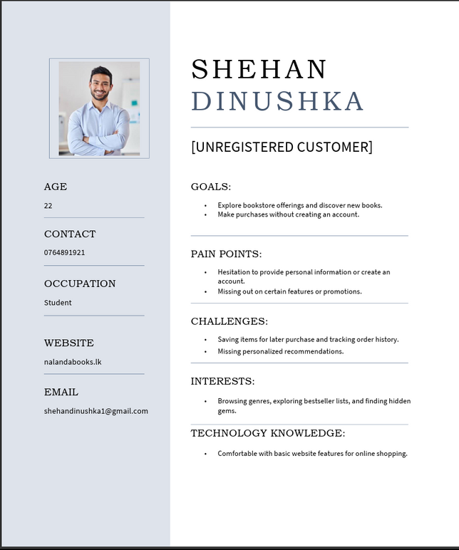
personas
Link : https://drive.google.com/drive/folders/1QRWazHb4pDEqhDokSXba6RNVIyGAShVE?usp=drive_link

Slide 7
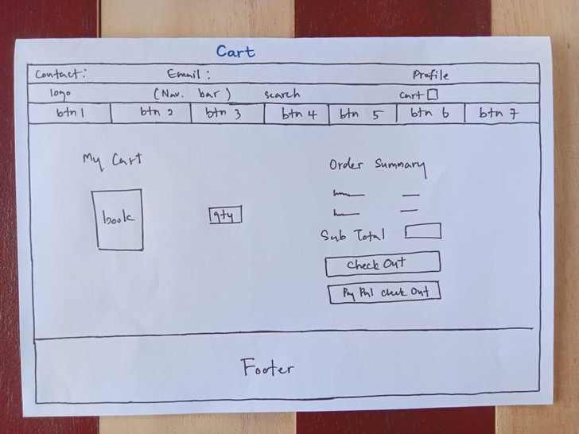
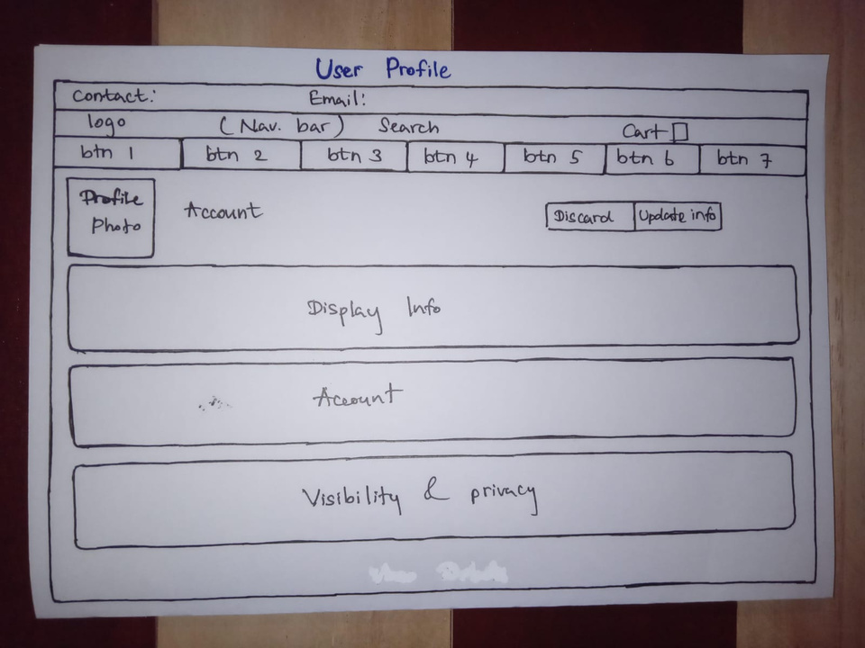
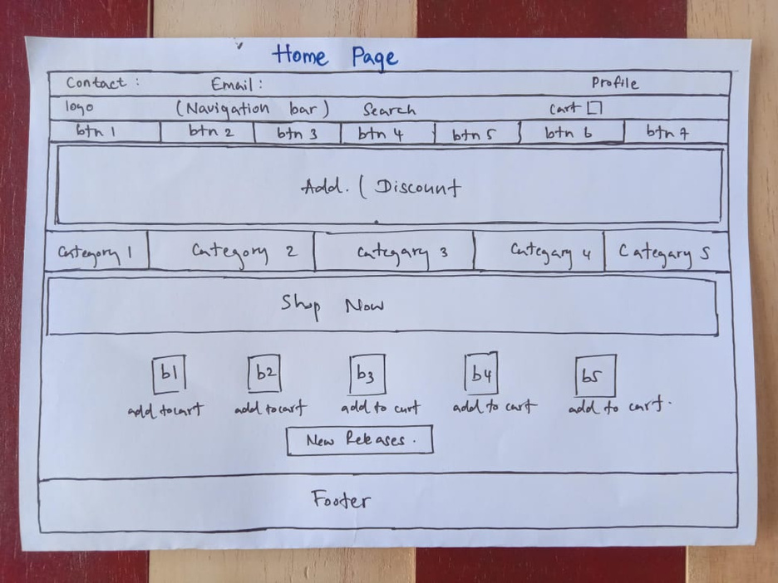
Sketches

Slide 8
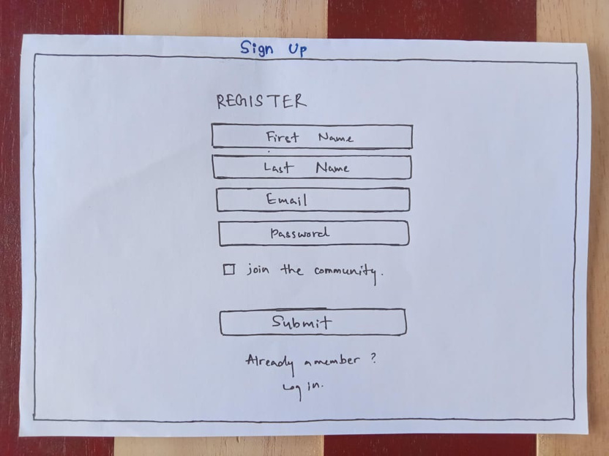
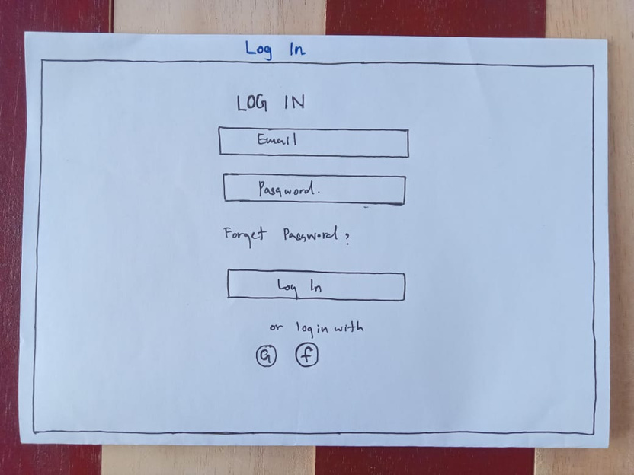
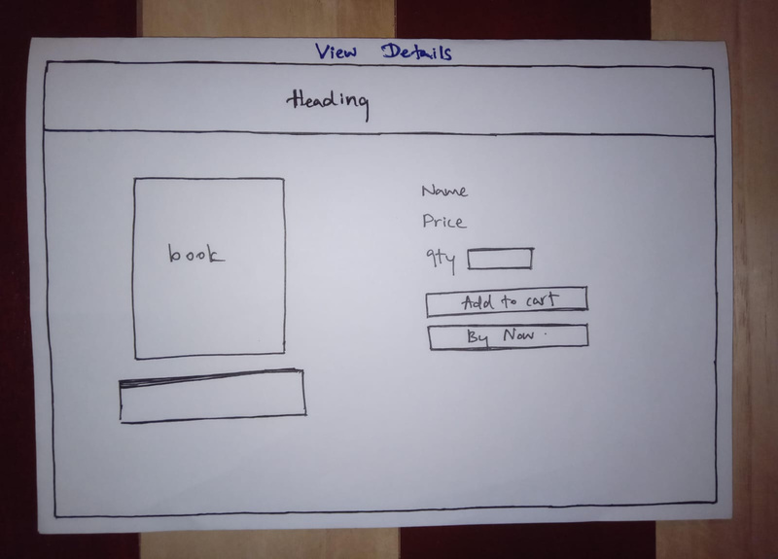

Slide 9


Design wireframe and
prototype

Slide 10
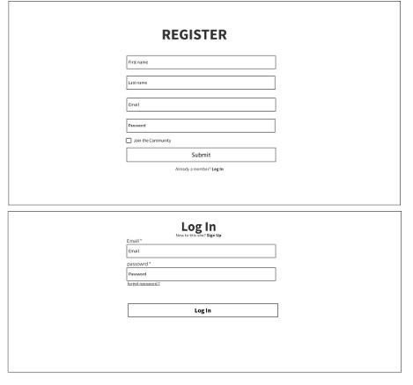
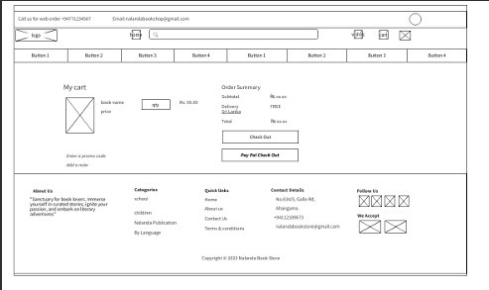
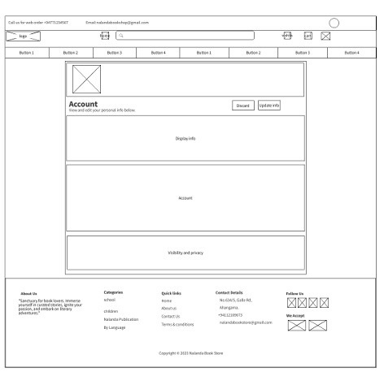
Wireframes
texthttps://drive.google.com/file/d/14CQFKhjzPNciIPIcZEedcFY3RLvW4kwP/view?usp=drive_link

Slide 11
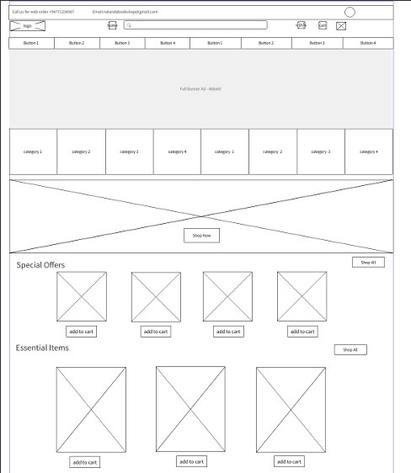
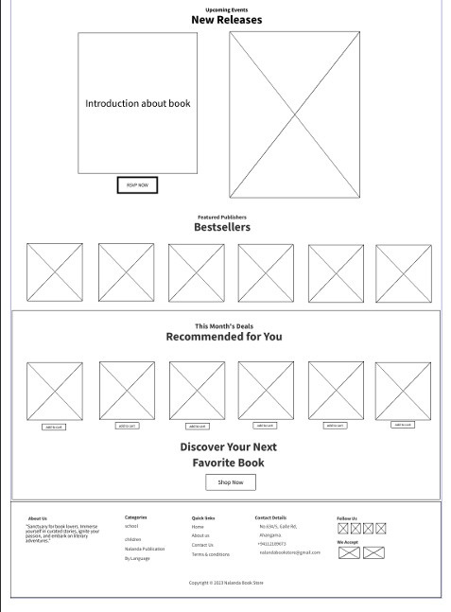

Slide 12
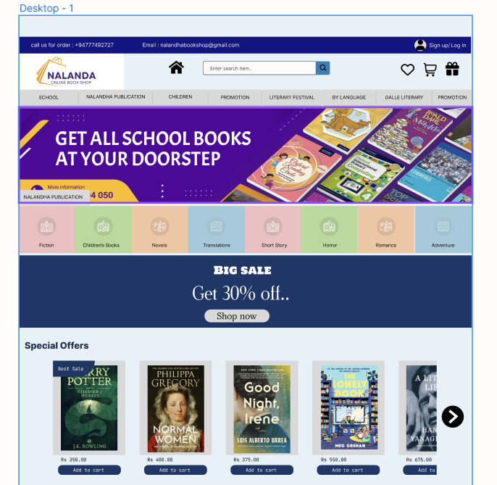
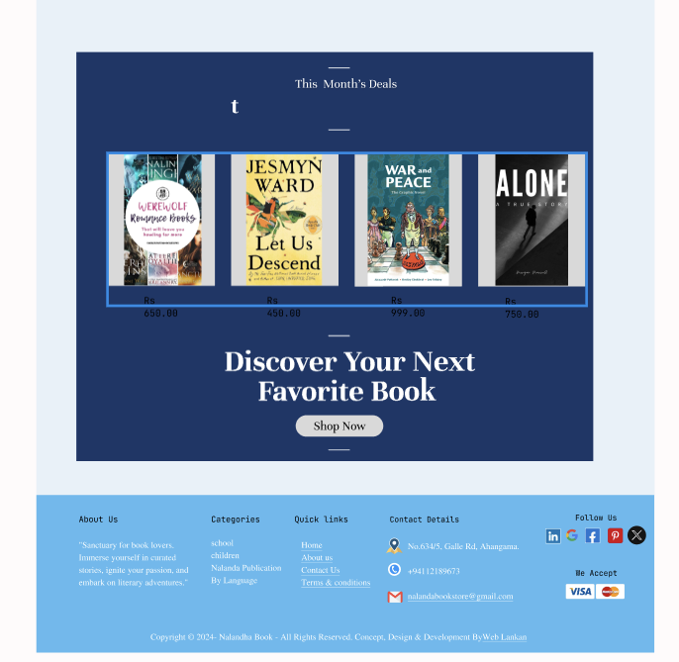
Prototypes

Slide 13
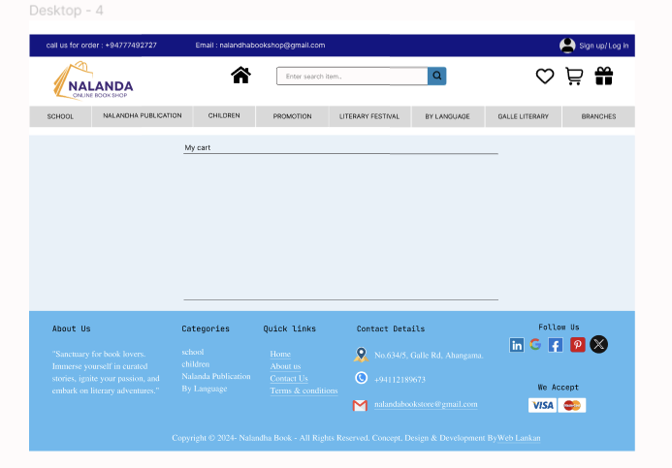
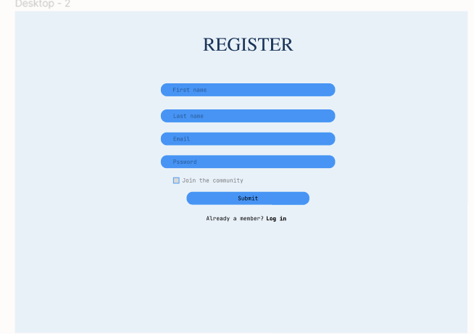
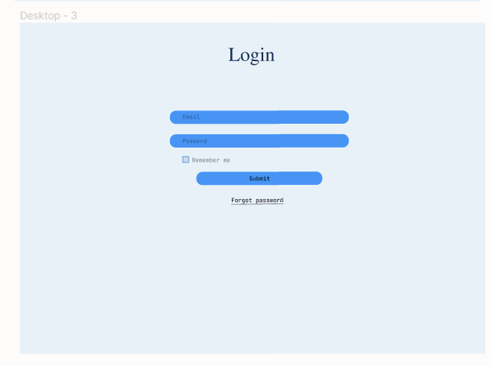
texthttps://www.figma.com/file/0IW7ZYfN0FULMEdo3VQM2I/Untitled?type=design&node-id=0%3A1&mode=design&t=lJfmLBVJyKg1b1FV-1

Slide 14


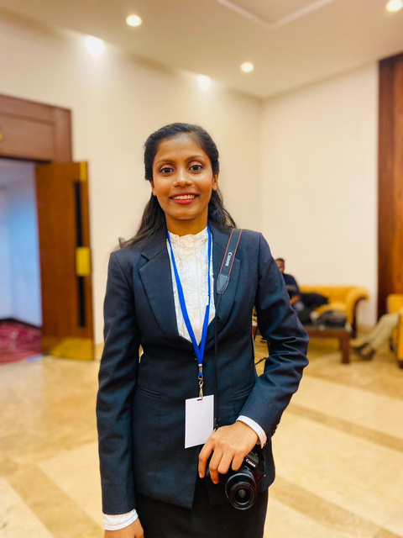


Our Team
M.A.H.D.Manchanayaka
Sandeepa Dulshan
W.C. Nimesha Fernando
Navodi Dilshara
W.M.Mahesh

Slide 15



Thank You For Your Attention!
Email Address
Website
group12workteam@gmail.com
www.workteam.com

